Slide 1
Color format
Nov, 2021

Slide 2
Color picture
To display color pictures on the screen. We need to use one color format.
Color format includes luma part and color parts for each pixel.
Storing color info takes up quite a lot of space so we need to compress it.
The most common technique to do so is to subsampling.
Notes:
The microkernel differs from an executive in how the IPC services are used to extend the functionality of the kernel with additional, service-providing processes. Since the OS is implemented as a team of cooperating processes managed by the microkernel, user-written processes can serve both as applications and as processes that extend the underlying OS functionality for industry-specific applications. The OS itself becomes "open" and easily extensible. Moreover, user-written extensions to the OS won't affect the fundamental reliability of the core OS.

Slide 3
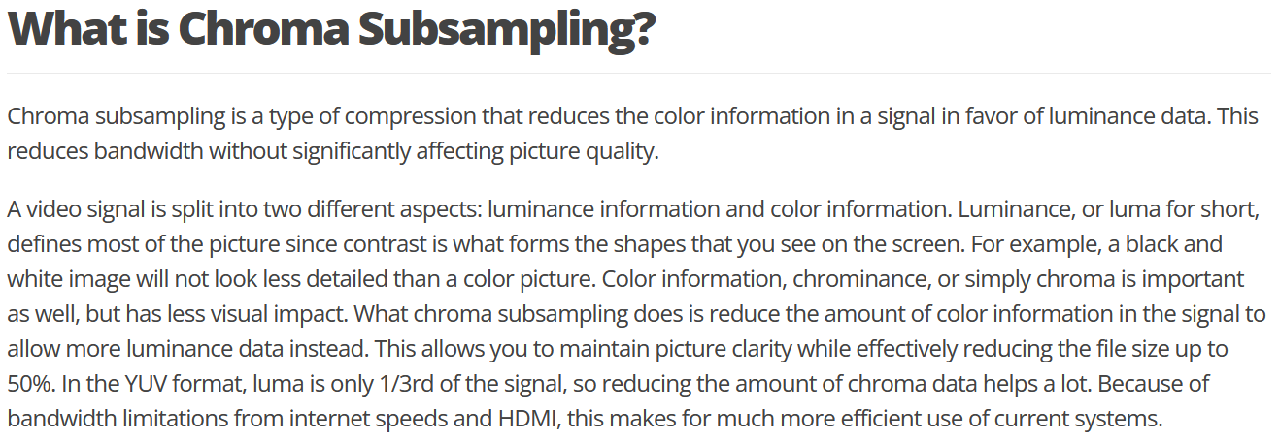
What is Chroma Subsampling

Slide 4
Some color format
Format | Description
SCREEN_FORMAT_BYTE
SCREEN_FORMAT_RGBA4444 | 16 bits per pixel (4 bits per channel) RGB with alpha channel.
SCREEN_FORMAT_RGBX4444 | 16 bits per pixel (4 bits per channel) RGB with alpha channel. disregarded.
SCREEN_FORMAT_RGBA5551 | 16 bits per pixel, 2 bytes containing R, G, and B values (5 bits per channel with single bit alpha channel).
SCREEN_FORMAT_RGBX5551 | 16 bits per pixel, 2 bytes containing R, G, and B values (5 bits per channel with single bit alpha channel, disregarded).
SCREEN_FORMAT_RGB565 | 16 bits per pixel; uses five bits for red, six bits for green and five bits for blue. This pixel format represents each pixel in the following order (high byte to low byte): RRRR RGGG GGGB BBBB.
SCREEN_FORMAT_RGB888 | 24 bits per pixel (8 bits per channel) RGB.
SCREEN_FORMAT_RGBA8888 | 32 bits per pixel (8 bits per channel) RGB with alpha channel .
SCREEN_FORMAT_RGBX8888 | 32 bits per pixel (8 bits per channel) RGB with alpha channel disregarded.
SCREEN_FORMAT_YVU9 | 9 bits per pixel planar YUV format. 8-bit Y plane and. 8-bit Y plane and 8-bit 4x4 subsampled V and U planes. Registered by Intel.
SCREEN_FORMAT_YUV420 | Standard NTSC TV transmission format.
SCREEN_FORMAT_NV12 | 12 bits per pixel planar YUV format. 8-bit Y plane and 2x2 subsampled, interleaved U and V planes.
SCREEN_FORMAT_YV12 | 12 bits per pixel planar YUV format. 8-bit Y plane and 8-bit 2x2 subsampled U and V planes.
SCREEN_FORMAT_UYVY | 16 bits per pixel packed YUV format. YUV 4:2:2 — Y sample at every pixel, U and V sampled at every second pixel horizontally on each line. A macropixel contains 2 pixels in 1 u_int32.
SCREEN_FORMAT_YUY2 | 16 bits per pixel packed YUV format. YUV 4:2:2 as in UYVY, but with different component ordering within the u_int32 macropixel.
SCREEN_FORMAT_YVYU | 16 bits per pixel packed YUV format. YUV 4:2:2 as for UYVY, but with different component ordering within the u_int32 macropixel.
SCREEN_FORMAT_V422 | Packed YUV format. Inverted version of UYVY.
SCREEN_FORMAT_AYUV | Packed YUV format. Combined YUV and alpha.

Slide 5
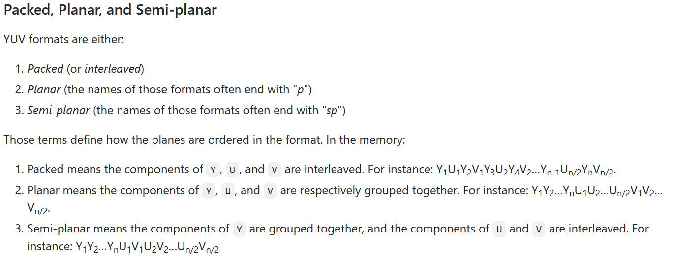
YUV format

Slide 6
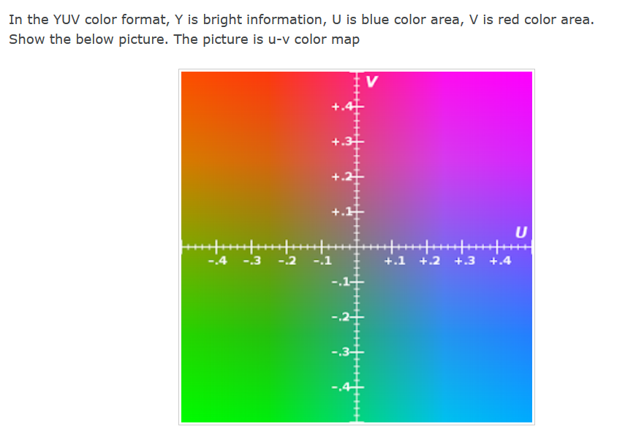

Slide 7
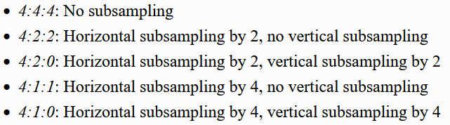
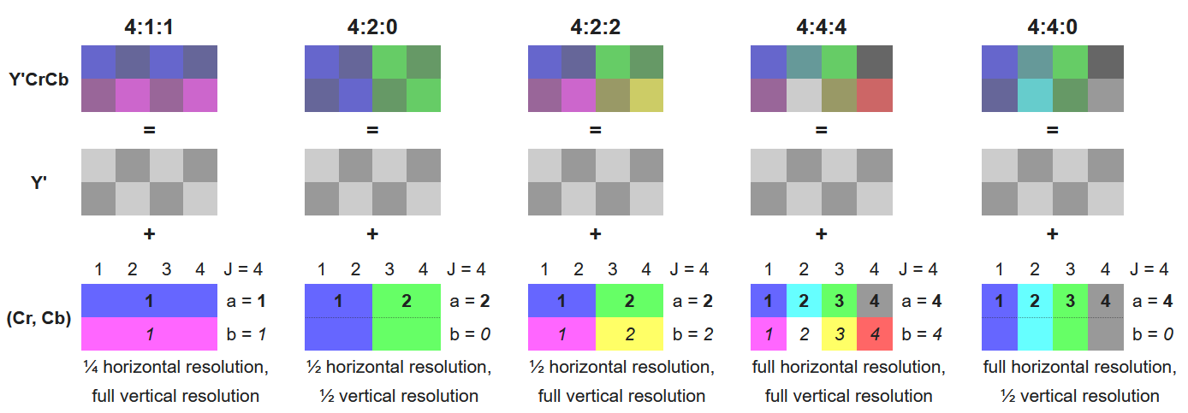
Chroma subsampling

Slide 8
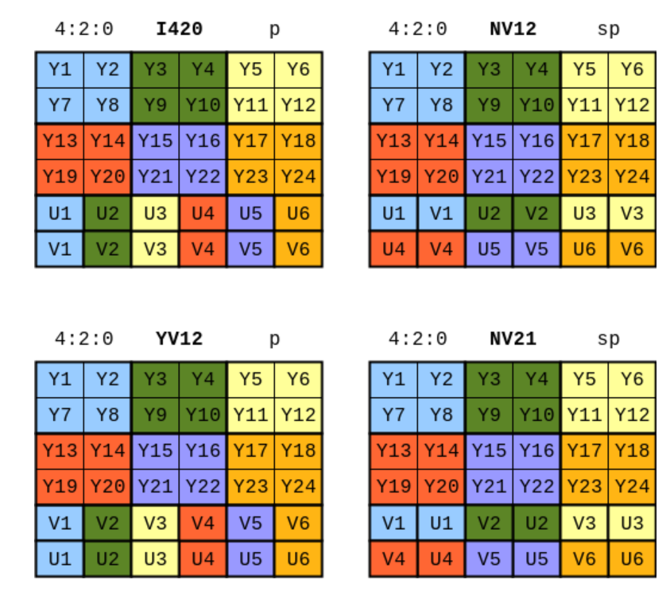
Chroma subsampling

Slide 9
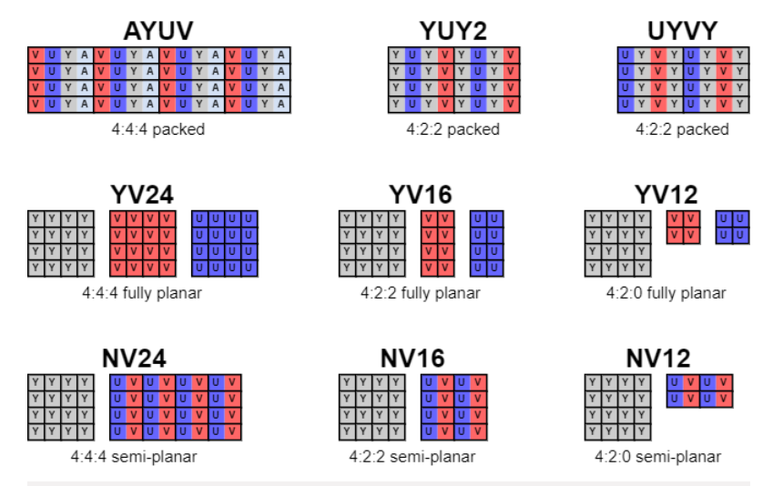
Chroma subsampling

Slide 10

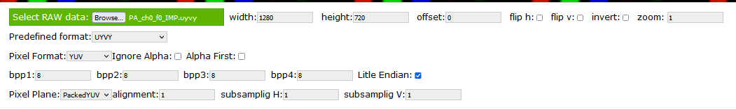
Use rawpixels to display image

Slide 11

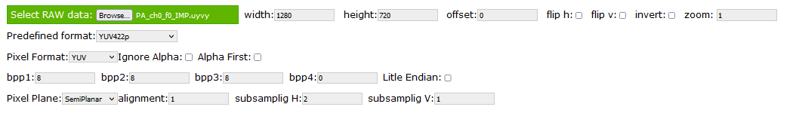
Use rawpixels to display image

Slide 12
Thank You!!

